Slide 1
Array properties and methods

Slide 2
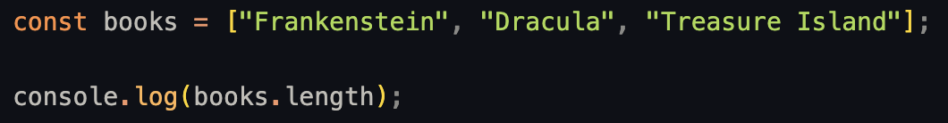

Property: Length
We can check how many elements an array has in a very simple way.
For example:
This will be very useful soon…

Slide 3
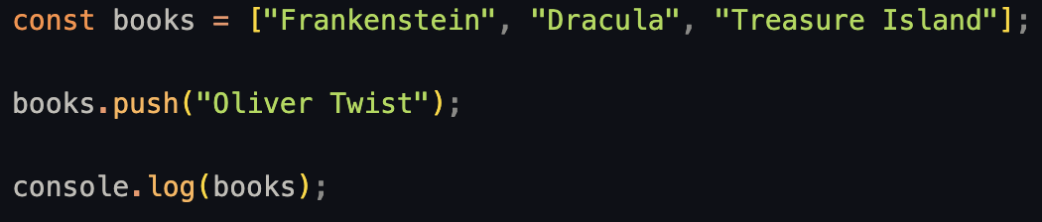
Method: push()
What if we want to add an item to our array?
For that we have the .push() method.

Slide 4
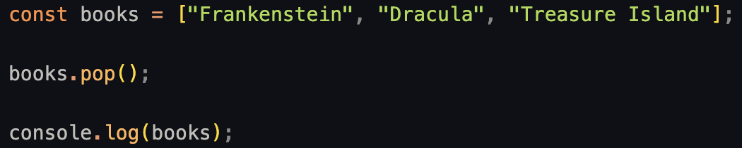
Method: pop()
In the same way, we can remove the last item of an array with .pop()

Slide 5
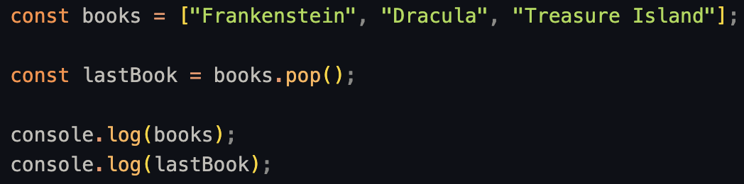

Method: pop()
This method (a type of function) will “return” the element that we just removed from the array

Slide 6
Properties and methods
We’ll get more in depth in the chapter regarding ‘Objects’ and ‘Functions’
For now we can think of properties as values we can read.
And we can think of methods as performing actions.

Slide 7
Methods
Keep in mind that bracket notation ( ex: myArray[1] ) simply “reads” the array: the array will not change.
But .push() and .pop() methods will “mutate” the array: the original array will change its content.

Slide 8
Exercise 3: Using your array books from earlier: Adding and Removing Books
Add a new book "Game of Thrones" to the end of the array.
Remove the first book from the array.
Log the updated array to the console.
Exercise 4: Finding the Length of an Array
Log the number of books in the array using .length

Slide 9
Methods
There are more array methods:
.shift() will remove the first element of the array
.unshift() method inserts new elements at the start of the array
.slice() will “return” a new array with the contents of part of the original array
.join() will “return” a string with every element in the array separated by commas
And many more. You can check them out here:
https://www.codecademy.com/resources/docs/javascript/arrays
https://developer.mozilla.org/en-US/docs/Web/JavaScript/Reference/Global_Objects/Array
https://dev.to/misszamzam/javascript-array-methods-a-beginners-guide-4hf4

Slide 10
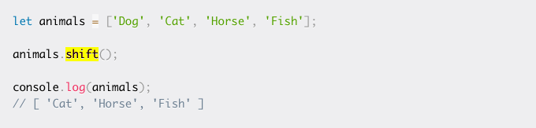
Shift
Use the shift() method to remove the first element

Slide 11
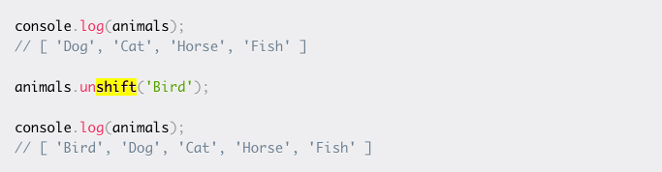
Unshift
the unshift() method inserts new elements at the start of the array

Slide 12
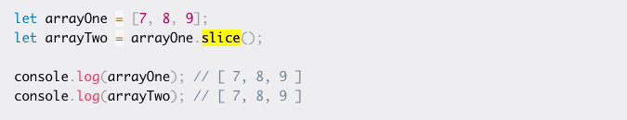
Slice
One way to copy an array is to use the slice() method, which is provided exactly for copying an array.
You only need to call the method and assign the returned array to a new variable like this:

Slide 13
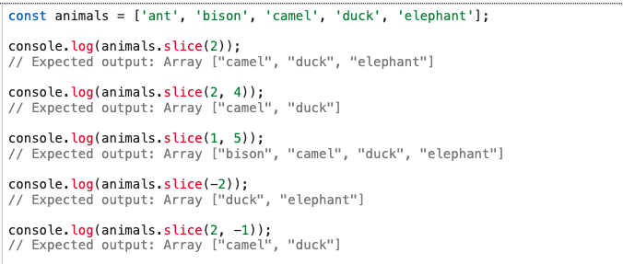
Slice cont
Notes:
-1 refers to the last element of the array.
-2 refers to the second-to-last element.
-3 refers to the third-to-last element, and so on.

Slide 14
const fruits = ["apple", "banana", "cherry", "date"];
Remove the first element from the array and store it in a variable
Log the modified array and the removed element
Notes:
SHIFT // "apple" is removed console.log(fruits); // ["banana", "cherry", "date"] console.log(removedFruit); // "apple"

Slide 15
const colors = ["blue", "green", "yellow"];
Add "red" to the beginning of the array
Log the modified array
Notes:
UNSHIFT console.log(colors); // ["red", "blue", "green", "yellow"]

Slide 16
const students = ["Alice", "Bob", "Charlie", "David", "Eve", "Frank"];
Use slice() to create a new array with only "Charlie" and "David", then log it.
Use slice() to get the last three students in the array, then log it.
Use slice() to copy the entire students array into a new array, then log it
Notes:
console.log(group1); // ["Charlie", "David"]
console.log(group2); // ["David", "Eve", "Frank"]
console.log(copyOfStudents); // ["Alice", "Bob", "Charlie", "David", "Eve", "Frank"]

